Slide 1
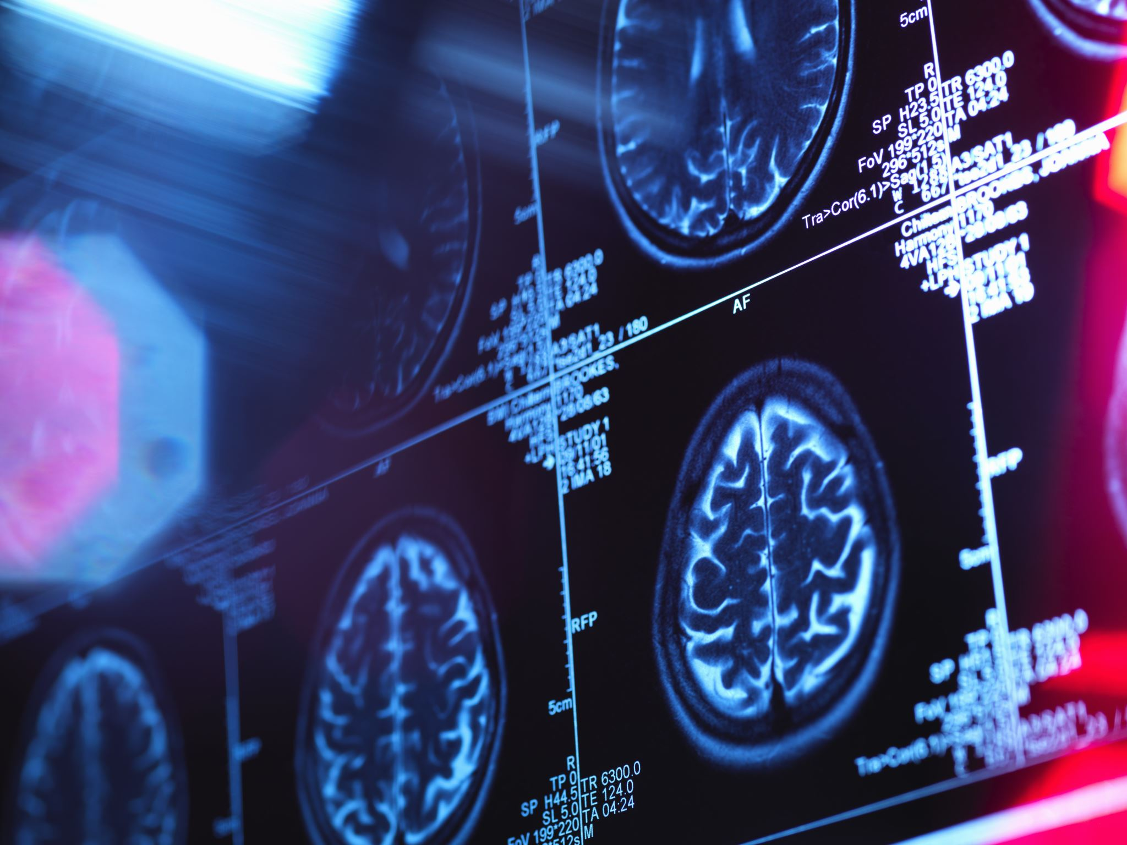
Brain Tumor MRI Classification with Deep Learning
Institute of data – Capstone 2023
Dhamma Ratana Laya

Slide 2
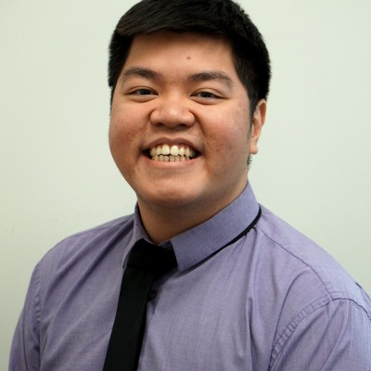
Biography
Bachelor of Food Technology (Hons)
6 years of experience Food Technologist:
1 year of sampling technologist
5 years of trainee/junior flavour chemist
Linkedin: https://www.linkedin.com/in/dhamma-laya-3380b610b

Slide 3
Contents
Introduction
Methodology
Results
Conclusions/Future Works
BUSINESS CASE

Slide 4
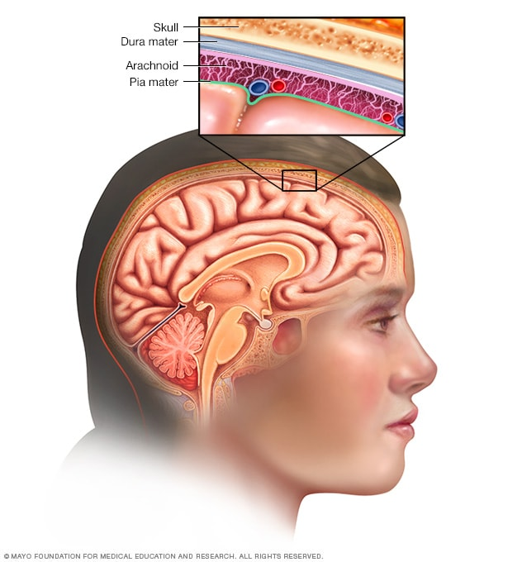
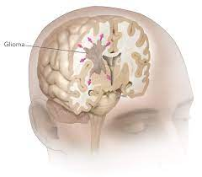
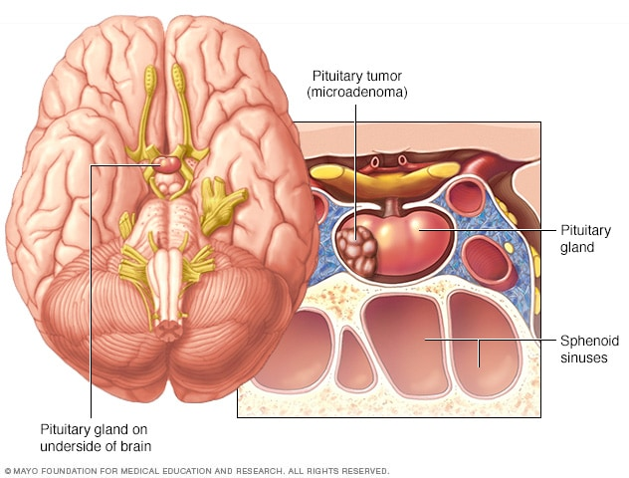
Introduction
Tumor – Abnormal cell growth
Brain tumor – 120 groups and counting
Benign and malignant (cancerous)
Range from children to adult
Glioma
Meningioma
Pituitary
https://www.nature.com/articles/s41571-019-0177-5
https://braintumor.org/brain-tumors/about-brain-tumors/brain-tumor-facts/

Slide 5
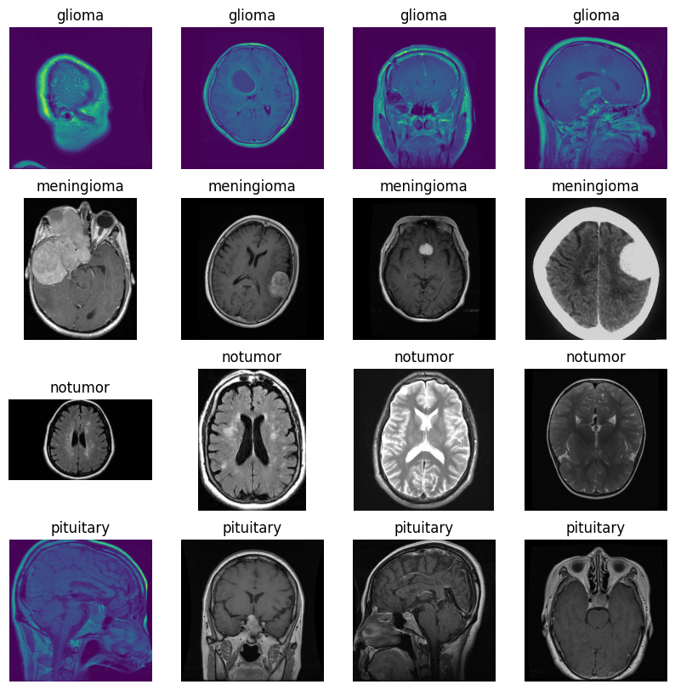
Sample MRI Images

Slide 6
Business case
Numerous types of tumor
Professional Neurosurgeon required for MRI
Developing countries lack skilful doctors
Objectives:
Make a model using a machine learning algorithm which can help detect and classify brain tumor based on MRI imaging.
Stakeholder
Hospitals
Patients
Insurance companies
Notes:
Hospitals: Enhancing the efficiency and accuracy of medical diagnoses. This can improve the reputation of healthcare institutions, reduce misdiagnosis, and lead to more effective resource allocation.
Patients: Improved diagnosis and early detection of brain tumors. The model can assist medical professionals in making accurate and timely decisions, leading to better patient outcomes and potentially reduced treatment costs.
Insurance: More accurate and early detection can result in better cost management. Insurers may see reduced payouts for late-stage treatments and improved risk assessment.
Government: AI-driven diagnosis can improve healthcare outcomes, reduce the burden on the healthcare system, and enhance public health. Regulatory bodies may need to establish guidelines and standards for such AI applications.

Slide 7

Objectives:
Make a model using a machine learning algorithm which can help detect and classify brain tumor based on MRI imaging.

Slide 8
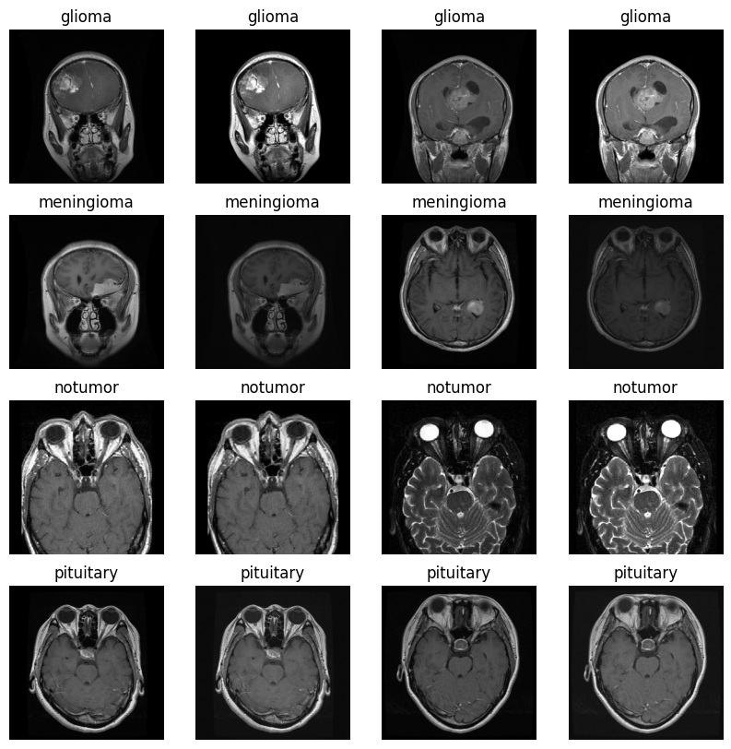
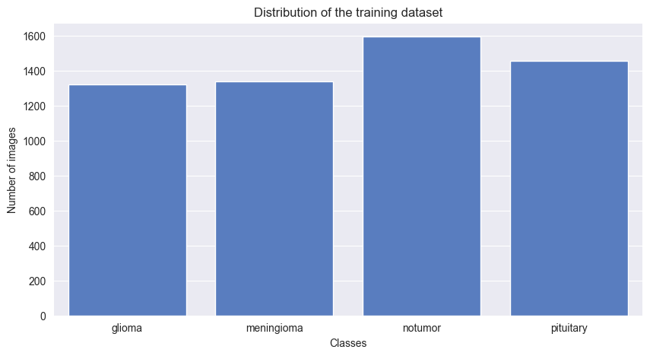
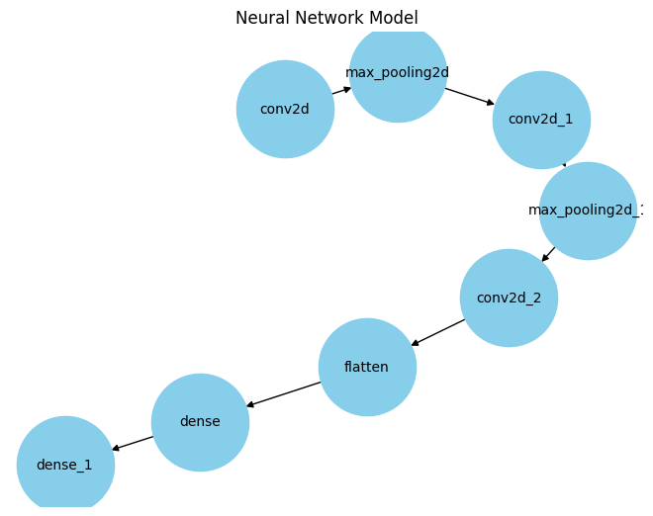
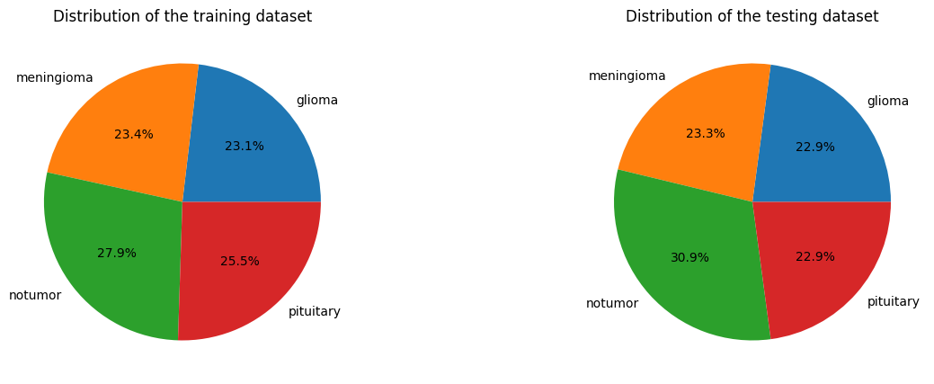
Methodology
Data collection
Data preprocessing
Image preprocessing
Model training – CNN
Model testing
Notes:
5,712 Training images
1,311 Test images

Slide 9
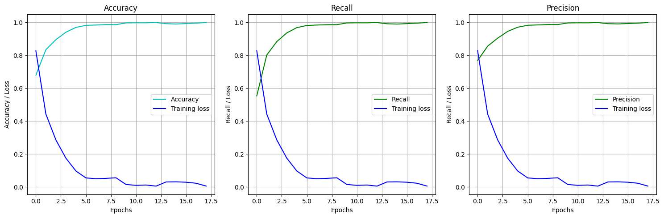
Results
Model performance on training dataset

Slide 10
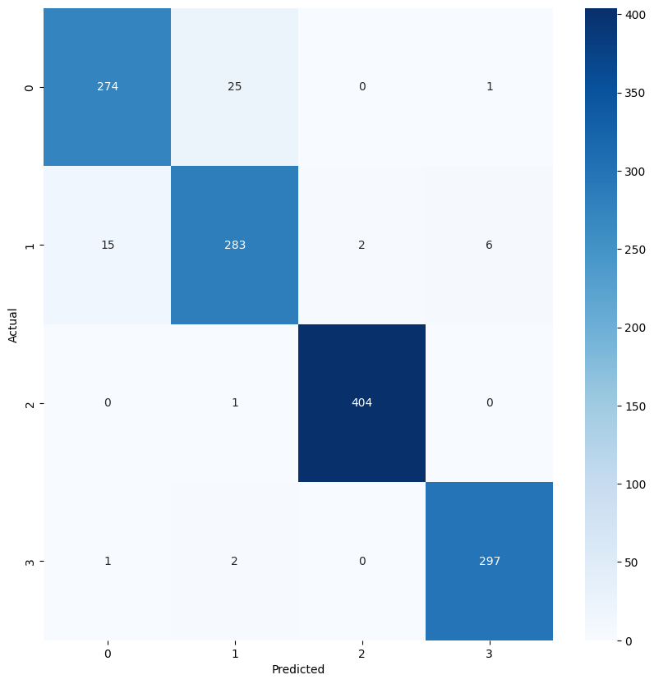
Results & Discussions
Category | Accuracy | Recall | Precision
Glioma [0] | 0.96 | 0.91 | 0.94
Meningioma [1] |  | 0.92 | 0.91
No tumour [2] |  | 1.00 | 1.00
Pituitary [3] |  | 0.99 | 0.98
Model performance on test dataset
Possible challenge: Interclass variability.
Confusion matrix on test dataset
https://pubmed.ncbi.nlm.nih.gov/27565475/#:~:text=Conclusions%3A%20Glioblastoma%20can%20mimic%20meningioma,can%20contribute%20to%20diagnostic%20confusion.

Slide 11
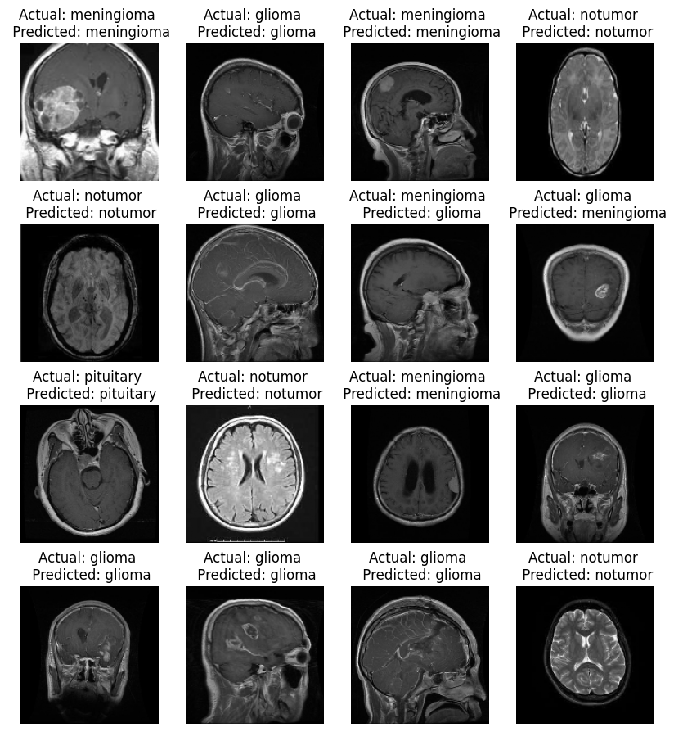

Predicted vs Actual value

Slide 12
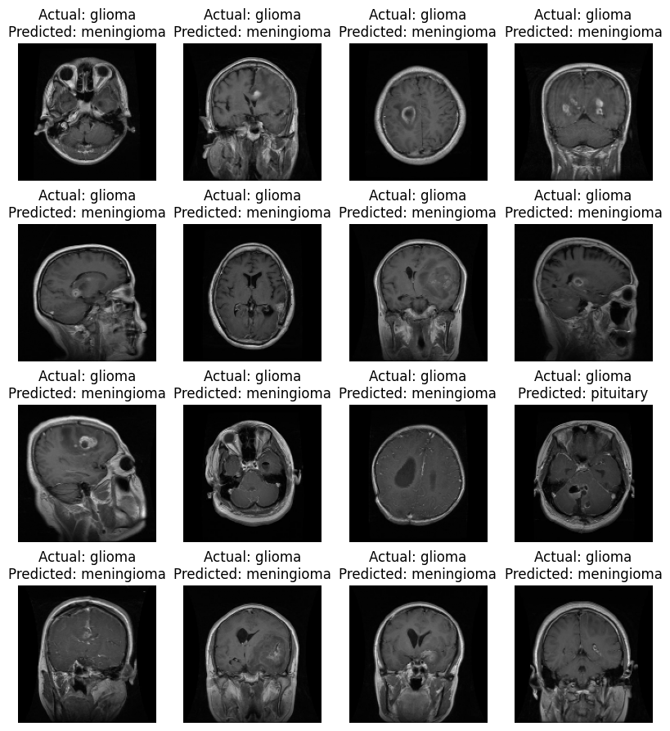
Misdiagnosed cases

Slide 13
Conclusion & Future work
Conclusions
Future works & challenges
The goal is to find a model which can help in detecting and classifying brain tumor; CNN with 96% accuracy.
Further tuning with more labelled dataset. Different pictures margin/size tuning.
High recall score (91-100%)
Application implementation in hospitals – Helps in detecting and classifying tumor.
Will the model be able to adapt with different image produced from different MRI machine?
What if the model is introduced to a rare type of tumor? Or rare case of glioma, meningioma, or pituitary?

Slide 14
Thank you!
Question??

